Slide 1

Presentation on “Sugarcane Crop Support System”
SAPTHAGIRI COLLEGE OF ENGINEERING
(Affiliated to Visvesvaraya Technological University, Belagavi & Approved by AICTE, New Delhi.)
Department of Computer Science & Engineering
Presented By:
Under the Guidance of :
Prof. Anuradha B
Assistant Professor,
Dept. of CSE
ASHWIN RAMESH P | 1SG16CS016
BINDHU M V | 1SG16CS020
DIVIJ N | 1SG16CS029
DIVYA K | 1SG16CS030

Slide 2
ABSTRACT
Sugarcane crop is grown in more than 90 countries and accounts upto 70% of sugar . Along with the diversity in the crop there is a huge spectrum of disease the plant can acquire.
The system is designed for accurate detection and suggestion of appropriate remedial measures.

Slide 3
INTRODUCTION
Sugarcane is the world's largest crop by production quantity, with 1.9 billion tonnes produced in 2016.
It is cultivated on about 26 million hectares.
Primarily grown in Brazil, India, China and Thailand.
Pests, insects, pathogens infect the plants resulting in decrease in the production to large scale if not controlled within time.

Slide 4
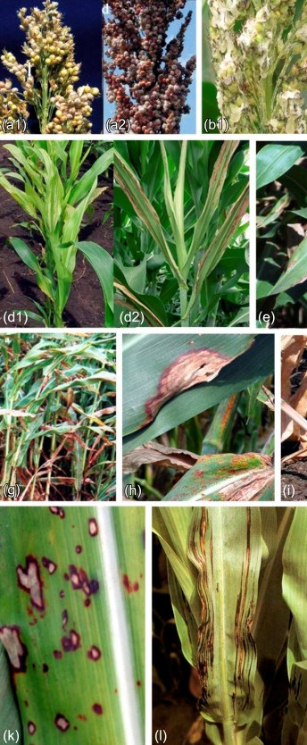
PROBLEM STATEMENT
To design and develop a system for detection and prevention of major sugarcane diseases.

Slide 5
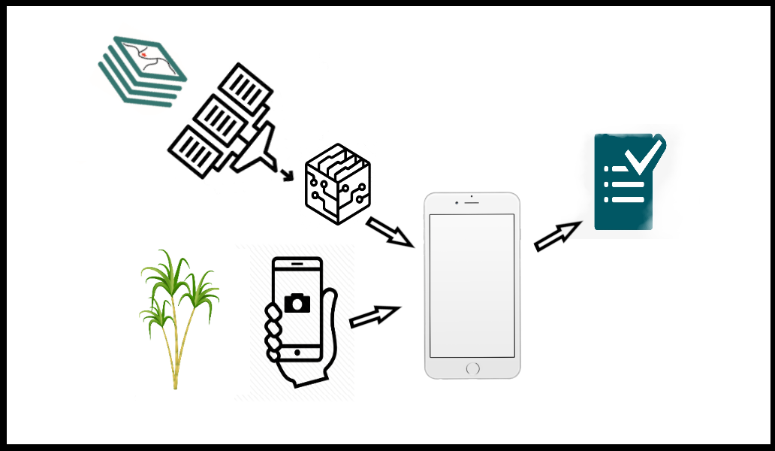
ARCHITECTURE
Preprocessing
Dataset
Trained Model
Predicted output
Test Data
Android Device

Slide 6
MODULE SPECIFICATION
ON DEVICE
TEST IMAGE
SERVER SIDE
DATASET
APPLICATION
PREPROCESSING
TRAINED MODEL
TRAINED MODEL
RESULT

Slide 7
METHODOLOGY

Slide 8
IMAGE PROCESSING
Image processing is a method to perform some operations on an image, in order to get an enhanced image or to extract some useful information from it.
Image processing basically includes the following three steps:
Importing the image via image acquisition tools
Analysing and manipulating the image
Output in which result can be altered image.

Slide 9
STEPS IN IMAGE PROCESSING
Resizing image.
Applying appropriate mask
Removing background noise.

Slide 10
TECHNIQUE USED IN IMAGE PROCESSING
HSV- Hue, Saturation, Value.
Hue: color or tint
Saturation: shade
Value:Brightness.
HSV color model makes object discrimination easier.
Most suitable color space for color based image segmentation.

Slide 11
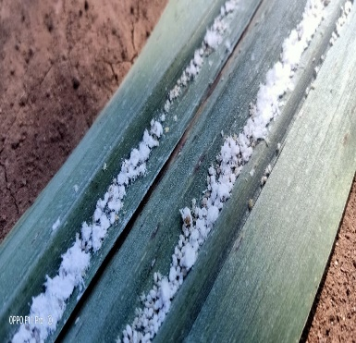
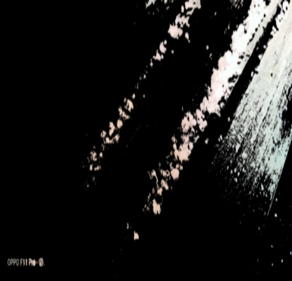
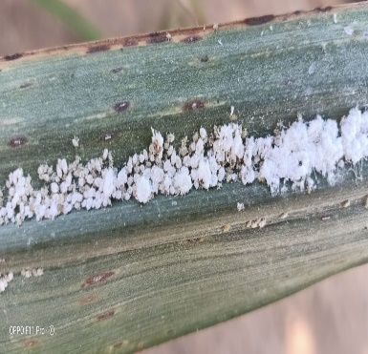
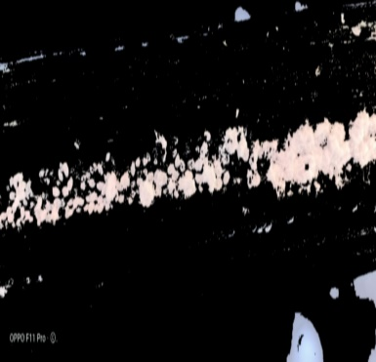
OBSERVED OUTPUT
Actual Image
Processed Image
Actual Image
Processed Image

Slide 12
FEATURE EXTRACTION
Feature extraction is the process by which certain features of interest within an image are detected and represented for further processing.
It marks the transition from pictorial to non-pictorial (quantitative) data representation.
The resulting representation can be subsequently used as an input for classification techniques.

Slide 13
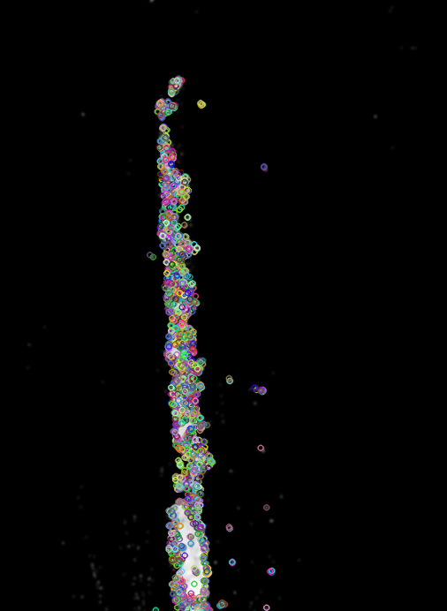
ORB FOR FEATURE EXTRACTION
ORB(Oriented Robust Binary)is used for feature extraction of the preprocessed images.
ORB in turn uses FAST key point detector and brief descriptors

Slide 14

FEATURE MATCHING
It is a task of establishing correspondence between 2 images
BruteForce Matcher is used for feature Matching

Slide 15
IMPLEMENTATION

Slide 16
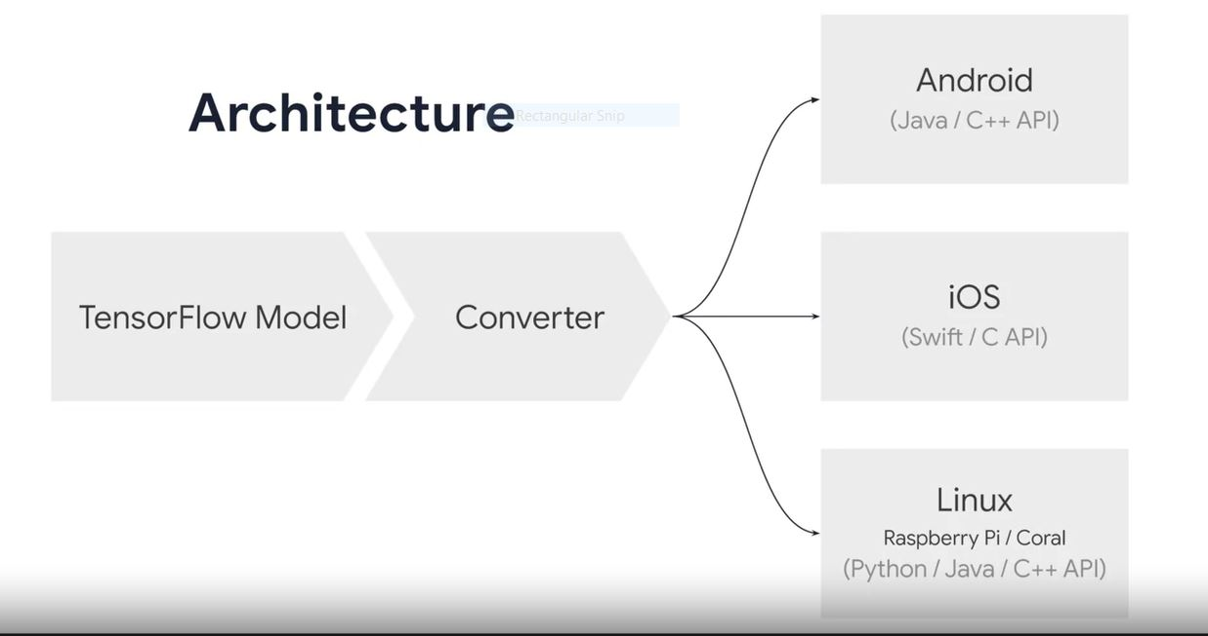
TENSORFLOW 2.0 ON DEVICE DEPLOYMENT

Slide 17
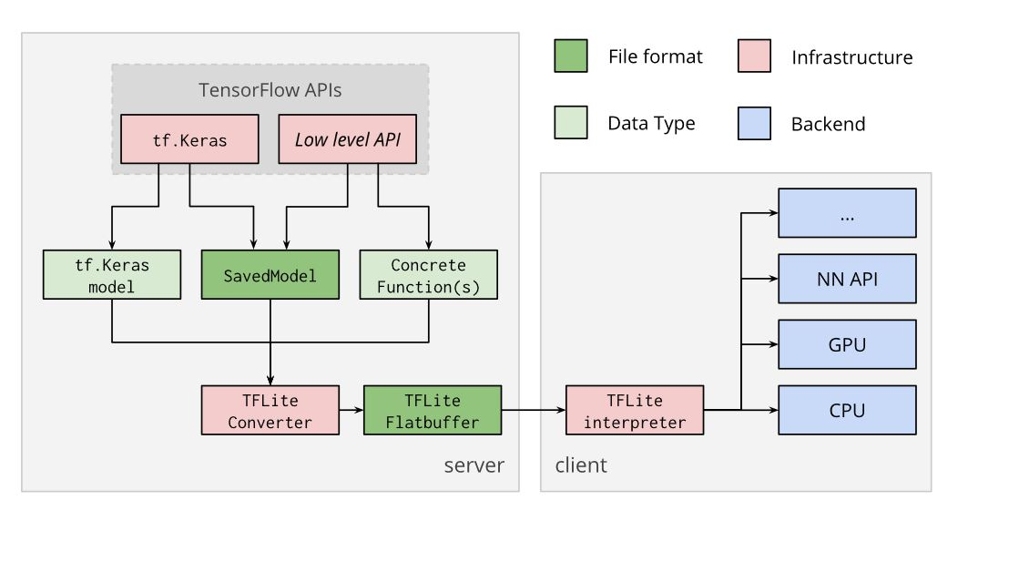
TENSORFLOW LITE CONVERTER

Slide 18
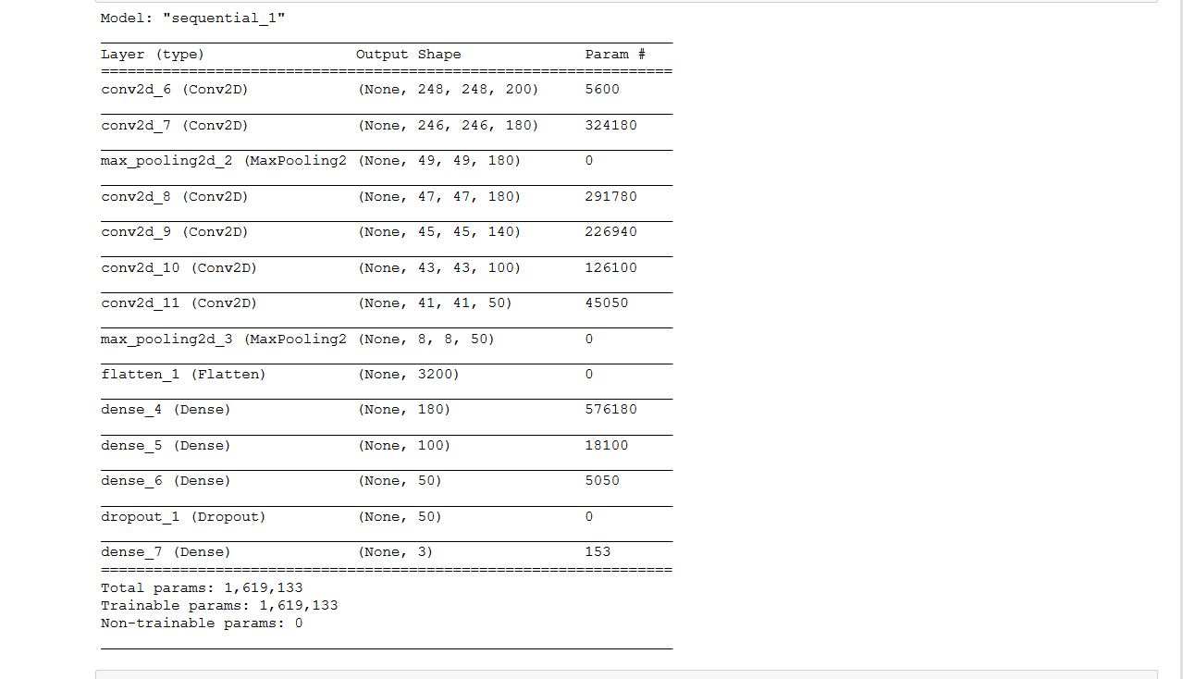
OUTPUTS
1. MODEL SUMMARY

Slide 19
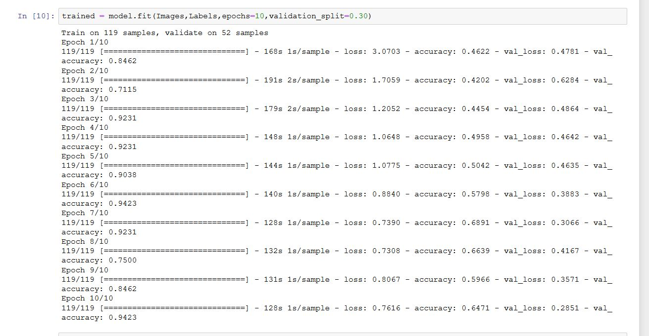
2.TRAINING THE MODEL

Slide 20
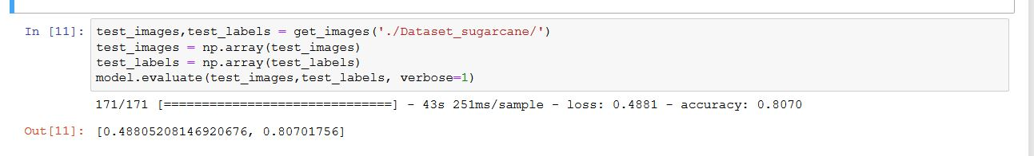
3.EVALUATE THE MODEL

Slide 21
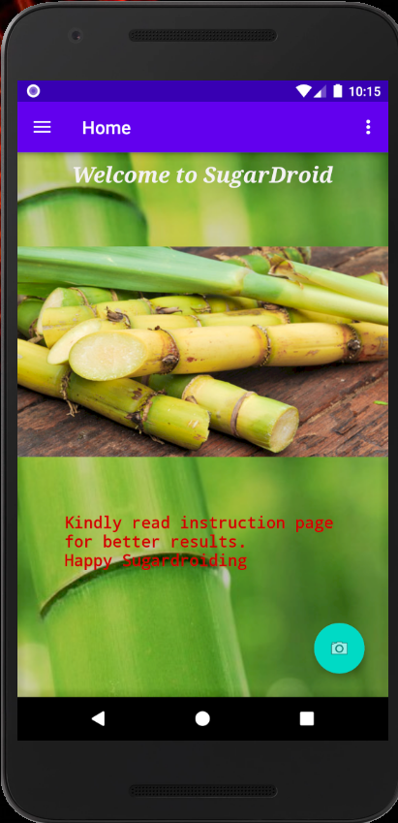
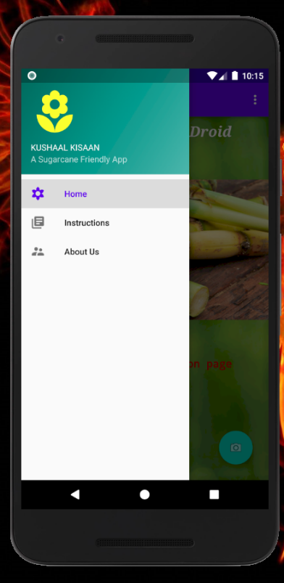
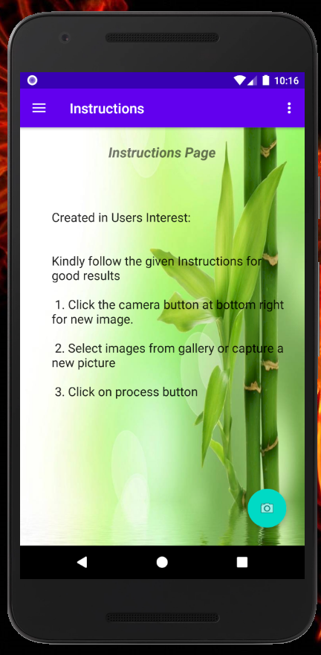

ANDROID APPLICATION

Slide 22
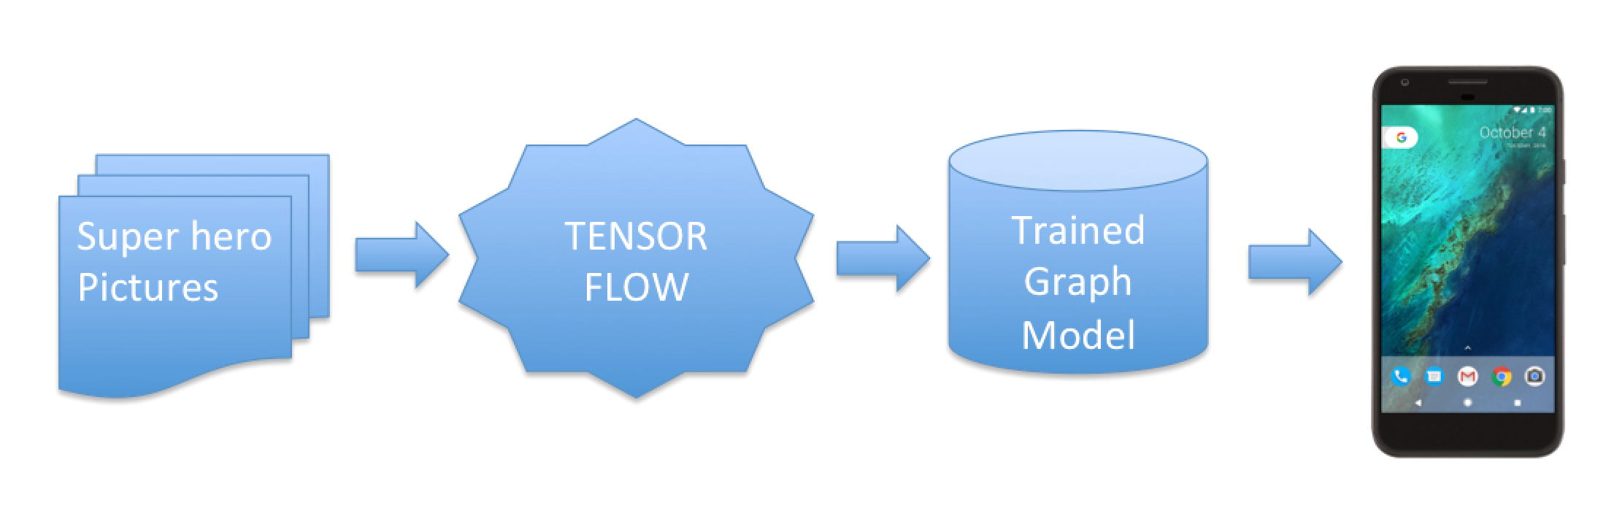
ANDROID + TF-LITE
Tensor flow integration on Android Application
Machine Learning made easy

Slide 23
THANK YOU

